Slide 1
Water Treatment Crash Course
30 minutes will give you the foundation you need

Slide 2
Please use Camera – Fill out info

Slide 3
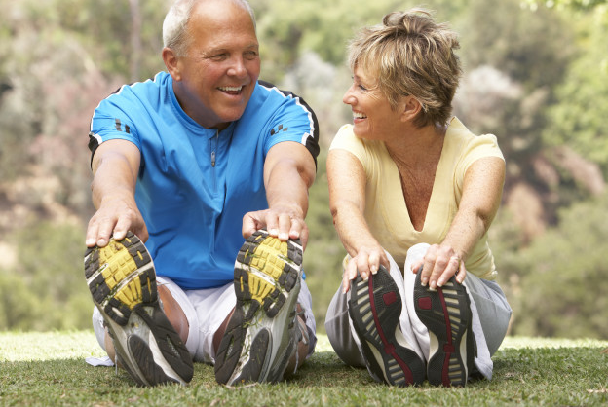
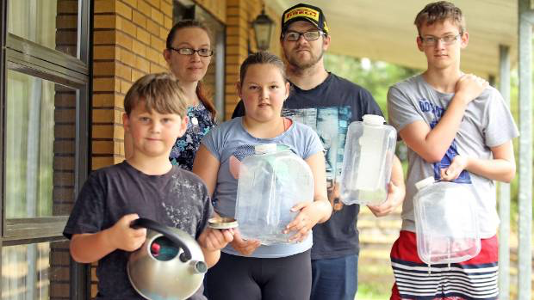
Who needs water treatment

Slide 4
Today’s Focus - Municipal Water
Dr. Oz advised viewers, “You should also shower and especially bathe with toxin free H20. Chlorine, which isn’t just found in swimming pools but also in our tap water - dries out the hair (as well as the skin). The problem isn’t the straight chlorine but what it turns into - stronger toxins called trihalomethanes. These can irritate your skin and eyes but may also cause other health problems in higher concentrations.”

Slide 5
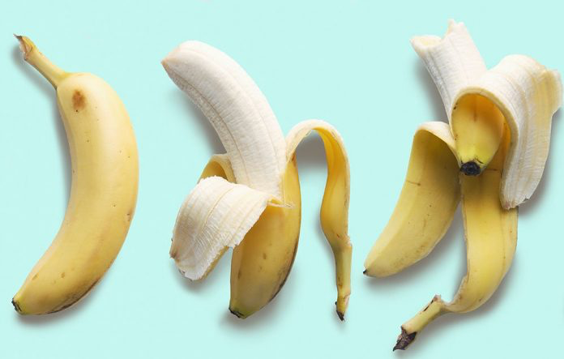
Chlorine / Chloramine

Slide 6
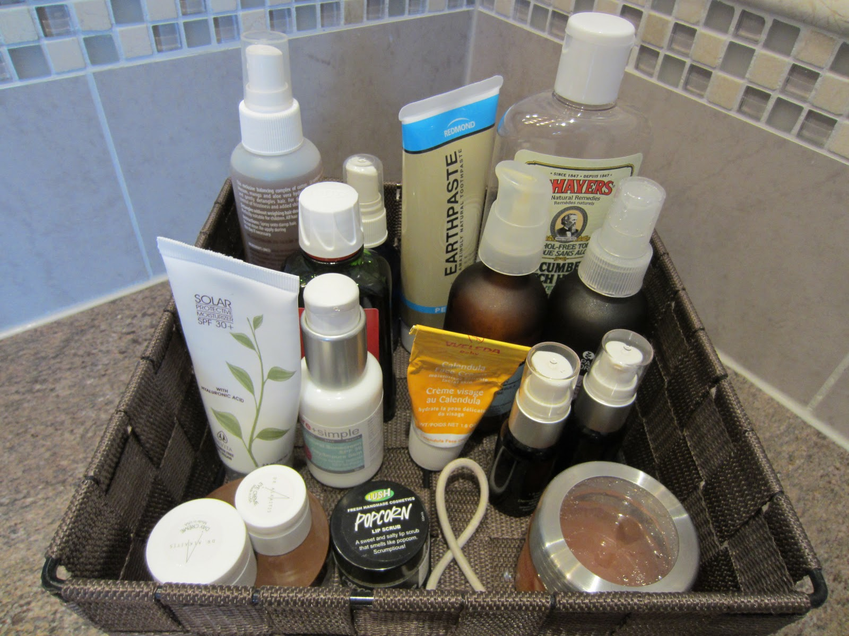
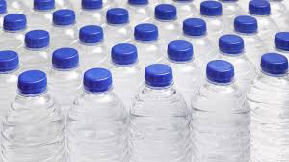
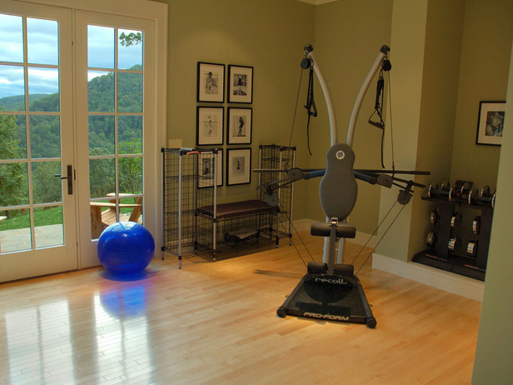
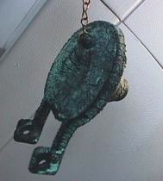
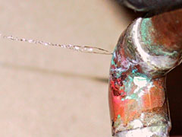
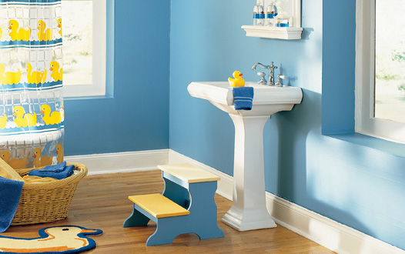
Where is the need for filtration evident?
Observing your customer and their home
Plumbing Signs
Leaks
Dried seals, flappers, etc
Lifestyle Clues
Bottled Water
Health Conscious
Kids
Recycle bins

Slide 7
The test tells them what they need to know
The average residential swimming pool is .5 – 1.5 ppm chlorine.
No one is drinking from the swimming pool by choice.
Nothing says water problems more clearly than showing the homeowner
their pink test tube results.

Slide 8
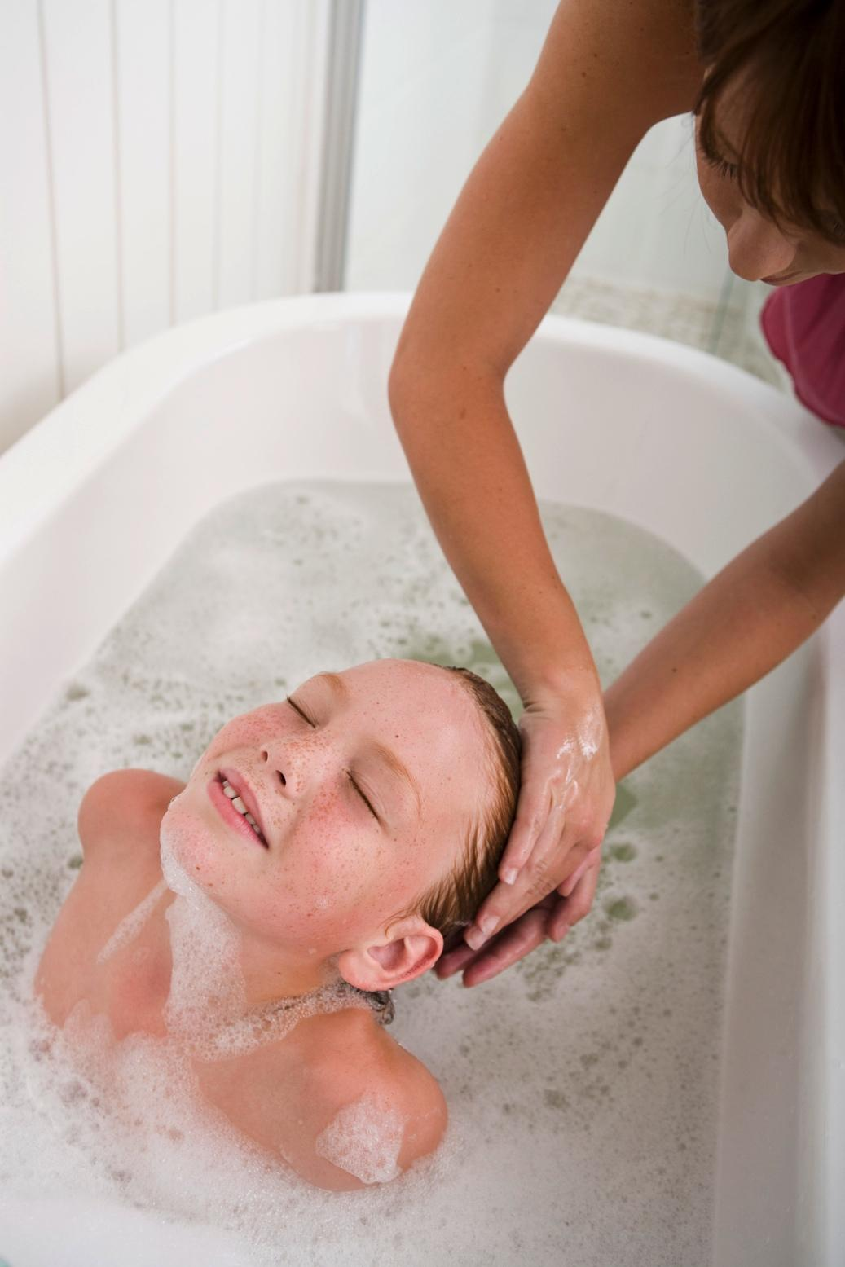
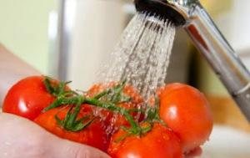
You can fix these problems with one filter
Cost effective, eco-friendly, convenient and all around awesome!
Clean water from every tap
Water taste and smells like pure water
No more drying affects of chlorine
No maintenance needed for 13+ family of 4 on average.
Life expectancy for chlorine removal 1.5 million gal.
Save money not buying bottled water
Be green by reducing bottled water waste

Slide 9
Carbon Filtration is Good -
Our filter is superior for several reasons
Top Quality Carbon
Smart Valve
Vortex Plate
Optional Neoprene Jacket

Slide 10
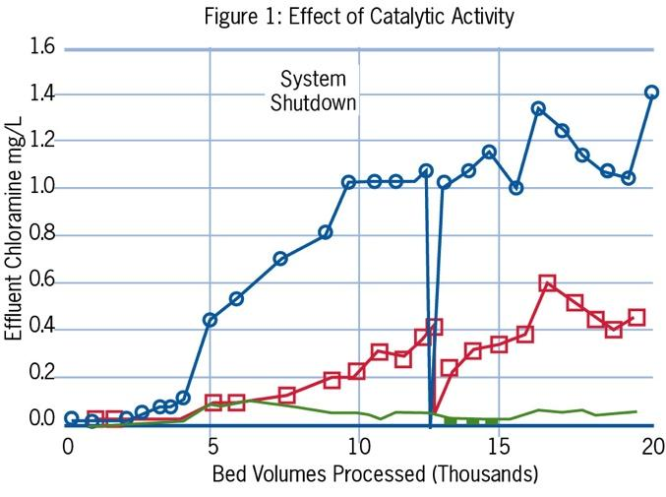
Know your carbon
Where does it come from?
Coconut or Coal?
Jacobi or Calgon?
Standard or Catalytic?
Are mixed bed systems better?

Slide 11
How Smart Can A Head Be?
Easily programmed
Stores data
Can adjust settings based on stored data

Slide 12
What’s so cool about a Vortech?

Slide 13
Optional Tank Jacket
Customized screen printing available
Insulation
Marketing
Appearance

Slide 14
What about “Hard Water”?
Water hardness typically is expressed in terms of dissolved calcium carbonate – in units of mg/l, ppm, or grains/gallon (gpg).
The U.S. Department of the Interior and the U.S. Geological Survey (USGS) defines water with over 7GPG is considered hard. In Nashville and the surrounding areas (within 60 miles) your average hardness is 10-20 GPG considered hard very hard water.
Notes:
The first part of this training is going over the basics
Definition
Locations
Signs / Symptoms
Can anyone tell me how hard water is defined?
Scale is a coating
or precipitate deposited on surfaces that
are in contact with hard water; water that
contains carbonates or bicarbonates of
calcium and/or magnesium is likely to
cause scale. When water is heated or
evaporation takes place or if there is a
change in water pressure, scale minerals
precipitate layers of rock-like deposits
inside pipes, water heaters, appliances,
equipment and fixtures.
Hard water contains higher-than-ordinary levels of dissolved minerals (strictly speaking, dissolved positive metallic ions) such as magnesium and calcium. Water from underground aquifers – well water, for you civilians – has extended contact with soft calcium and magnesium-bearing rock and mineral deposits such as limestone, chalk, dolomite, and marble, and small amounts of minerals are dissolved into an ionic solution in the water. Often the dissolution process is facilitated by carbon dioxide in the water, which forms a weak carbonic acid. Surface water generally doesn't contain enough calcium and magnesium to be considered hard, although there can be exceptions.

Slide 15
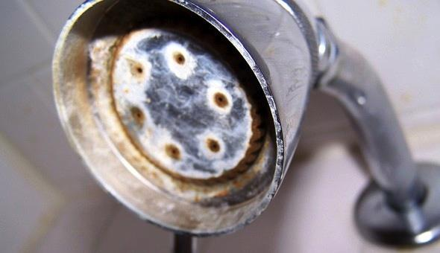
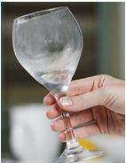
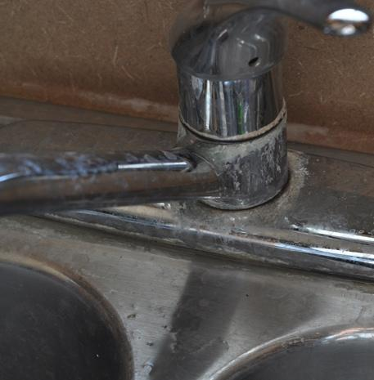
What does Hard Water hurt? Show the Signs!!!
Showers / Baths buildup
Faucets / Fixtures buildup
Water Flow
Water Heater efficiency
Dishes / Glasses clouding
Soap Scum
Water Heater failing prematurely
Water using appliances failing prematurely

Slide 16
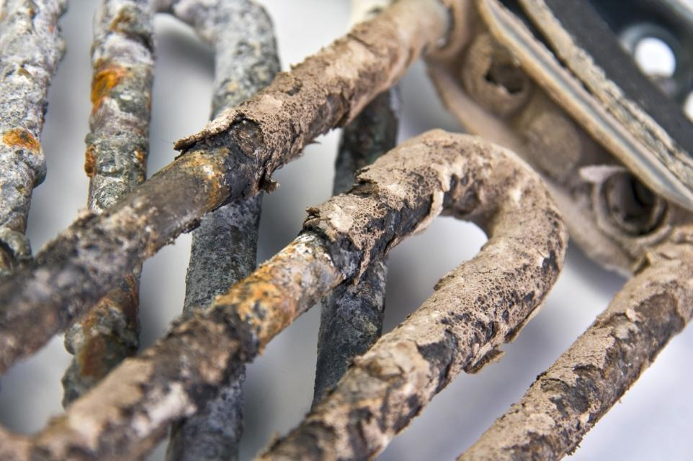
How does Scale form?
Increase in temperature
Decrease in pressure
It’s called Super Saturation
Supersaturated solutions are prepared or result when some condition of a saturated solution is changed, for example:
Increasing temperature - water heaters, shower valves, faucets, dishwashers, washing machines
Decreasing pressure – Regulators

Slide 17
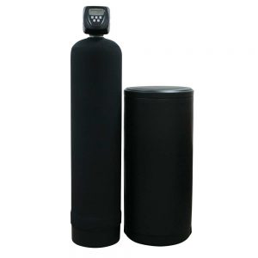
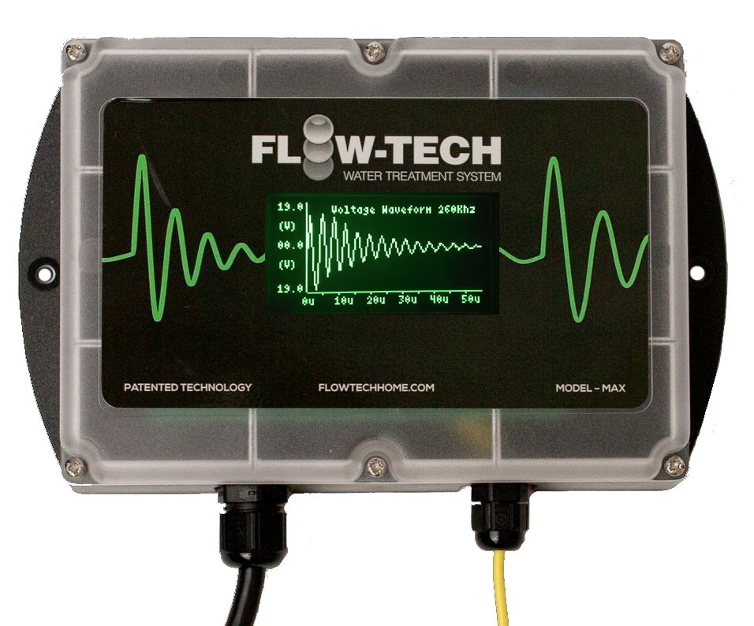
Options for Scale Control
VS.

Slide 18
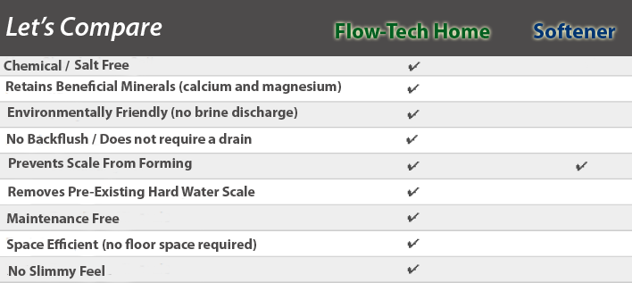
Understand the Differences
and Benefits
Give them what they want

Slide 19
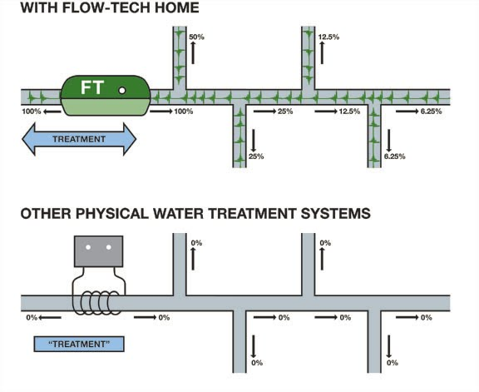
Why Flow-Tech Works
Mastery of Science:
Physical Water Treatment is a process utilizing a form of energy to alter the behavior of specific, targeted compounds or elements within water in order to accomplish a specific goal without significantly altering the water chemistry.
Effective
Consistent
Testable

Slide 20
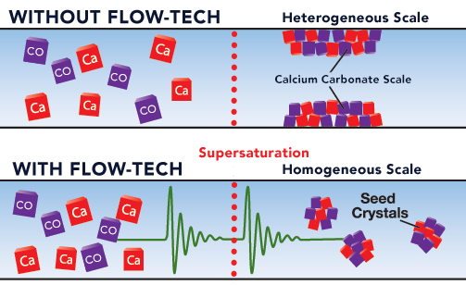
How does Flow-Tech Home work
Notes:
At the point of super saturation where heterogeneous scale formation traditionally occurs inside the tank and on the interior of the pipes, because of the charged state induced by the FLOW-TECH Home unit, the minerals will stick to each other forming homogeneous scale instead and will continue to flow harmlessly through the system.
In lay terms this means that regardless of whether the water is flowing or not, minerals will not resort back to their original state.

Slide 21
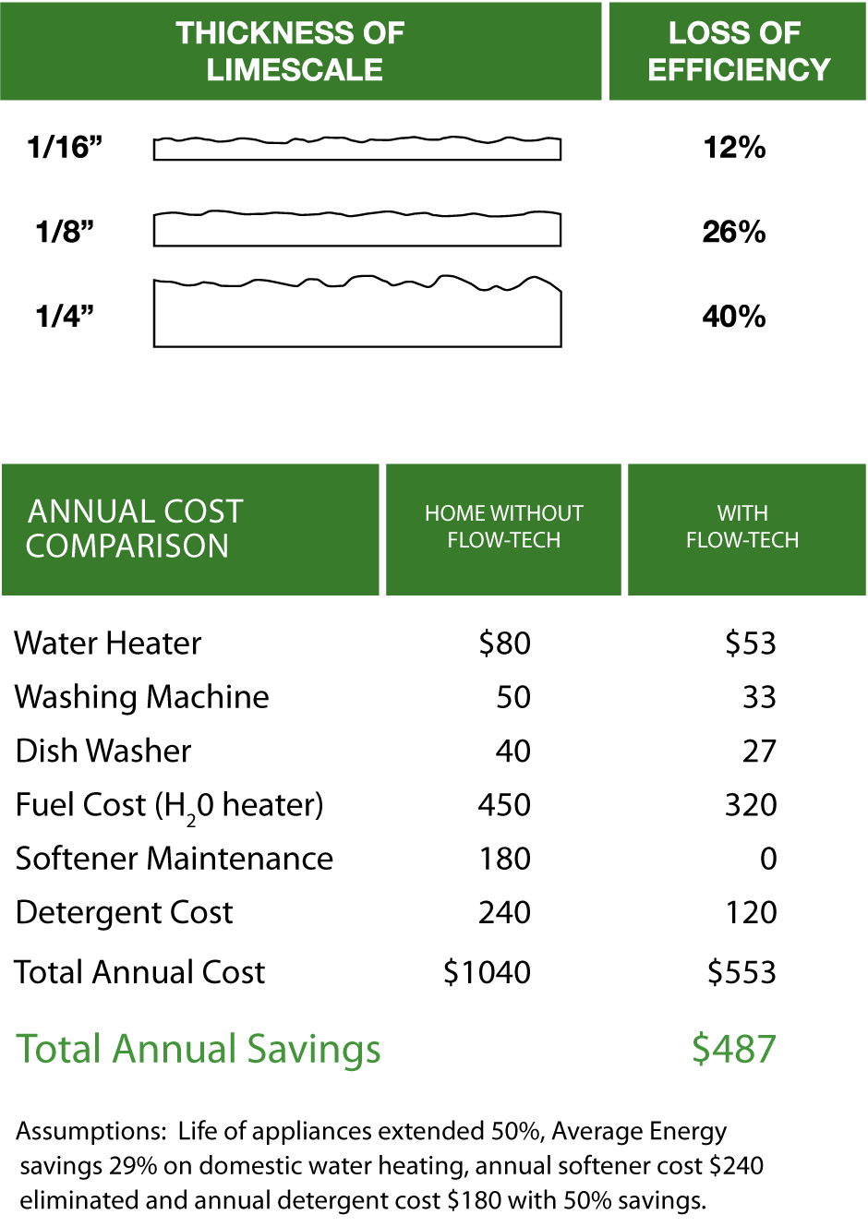
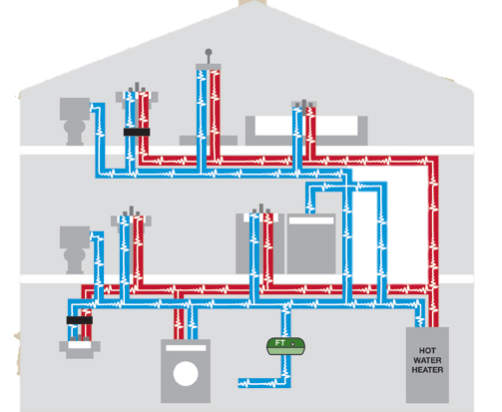
Where does Flow-Tech Home work EVERYWHERE pressurized water runs
Notes:
The System is installed at the point of entry to treat your entire home, both hot and cold water, or it can be located directly before a water heater or other device that requires protection from hard water.
The Anti-Scale System should be used in tandem with the Whole house carbon filter for optimal health, comfort and positive eco impact.

Slide 22
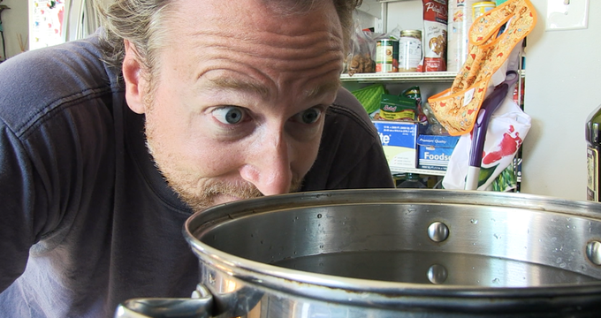
Water Heater Efficiency
½ Inch Of Mineral Buildup = 70% Efficiency Loss

Slide 23
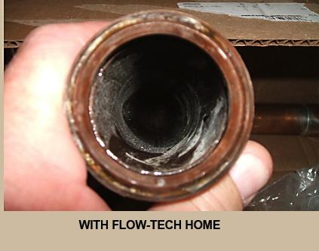
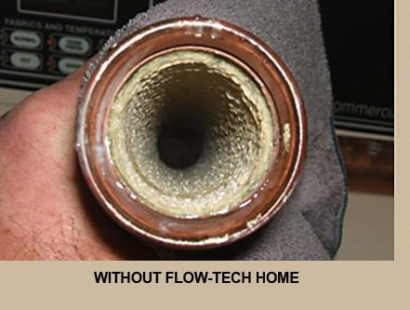
Notes:
The Flow-Tech System was developed from years of research by a team of top petrochemical engineers and scientists for use in large industrial applications.
We have adapted this technology to make it available to homeowners. For the first time you can have an economical, eco-friendly, no-maintenance water treatment system that works—all the time.

Slide 25
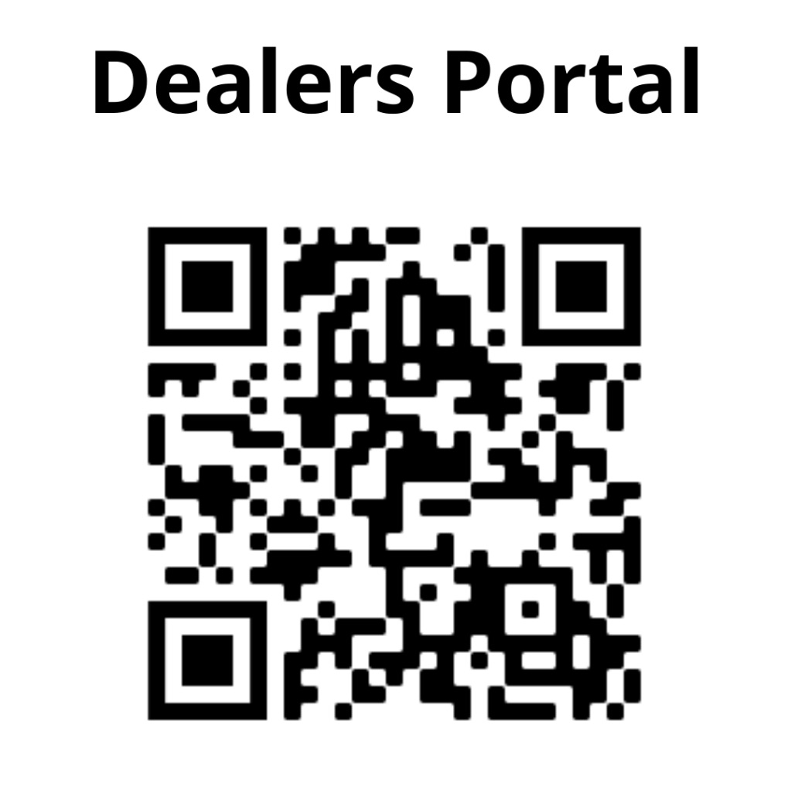

Slide 26
Need Help / Want More
David Johnson – Trainer Support
www.plumberschoicewater.com/dealers
Facebook – Flow-tech home techs
Water School – WaterSchool.online
We can do on site training or webinars
Call anytime for sales or technical support
Cell # 847-691-5267
Office # 615-866-6100
Or message me on FaceBook

